Slide 1

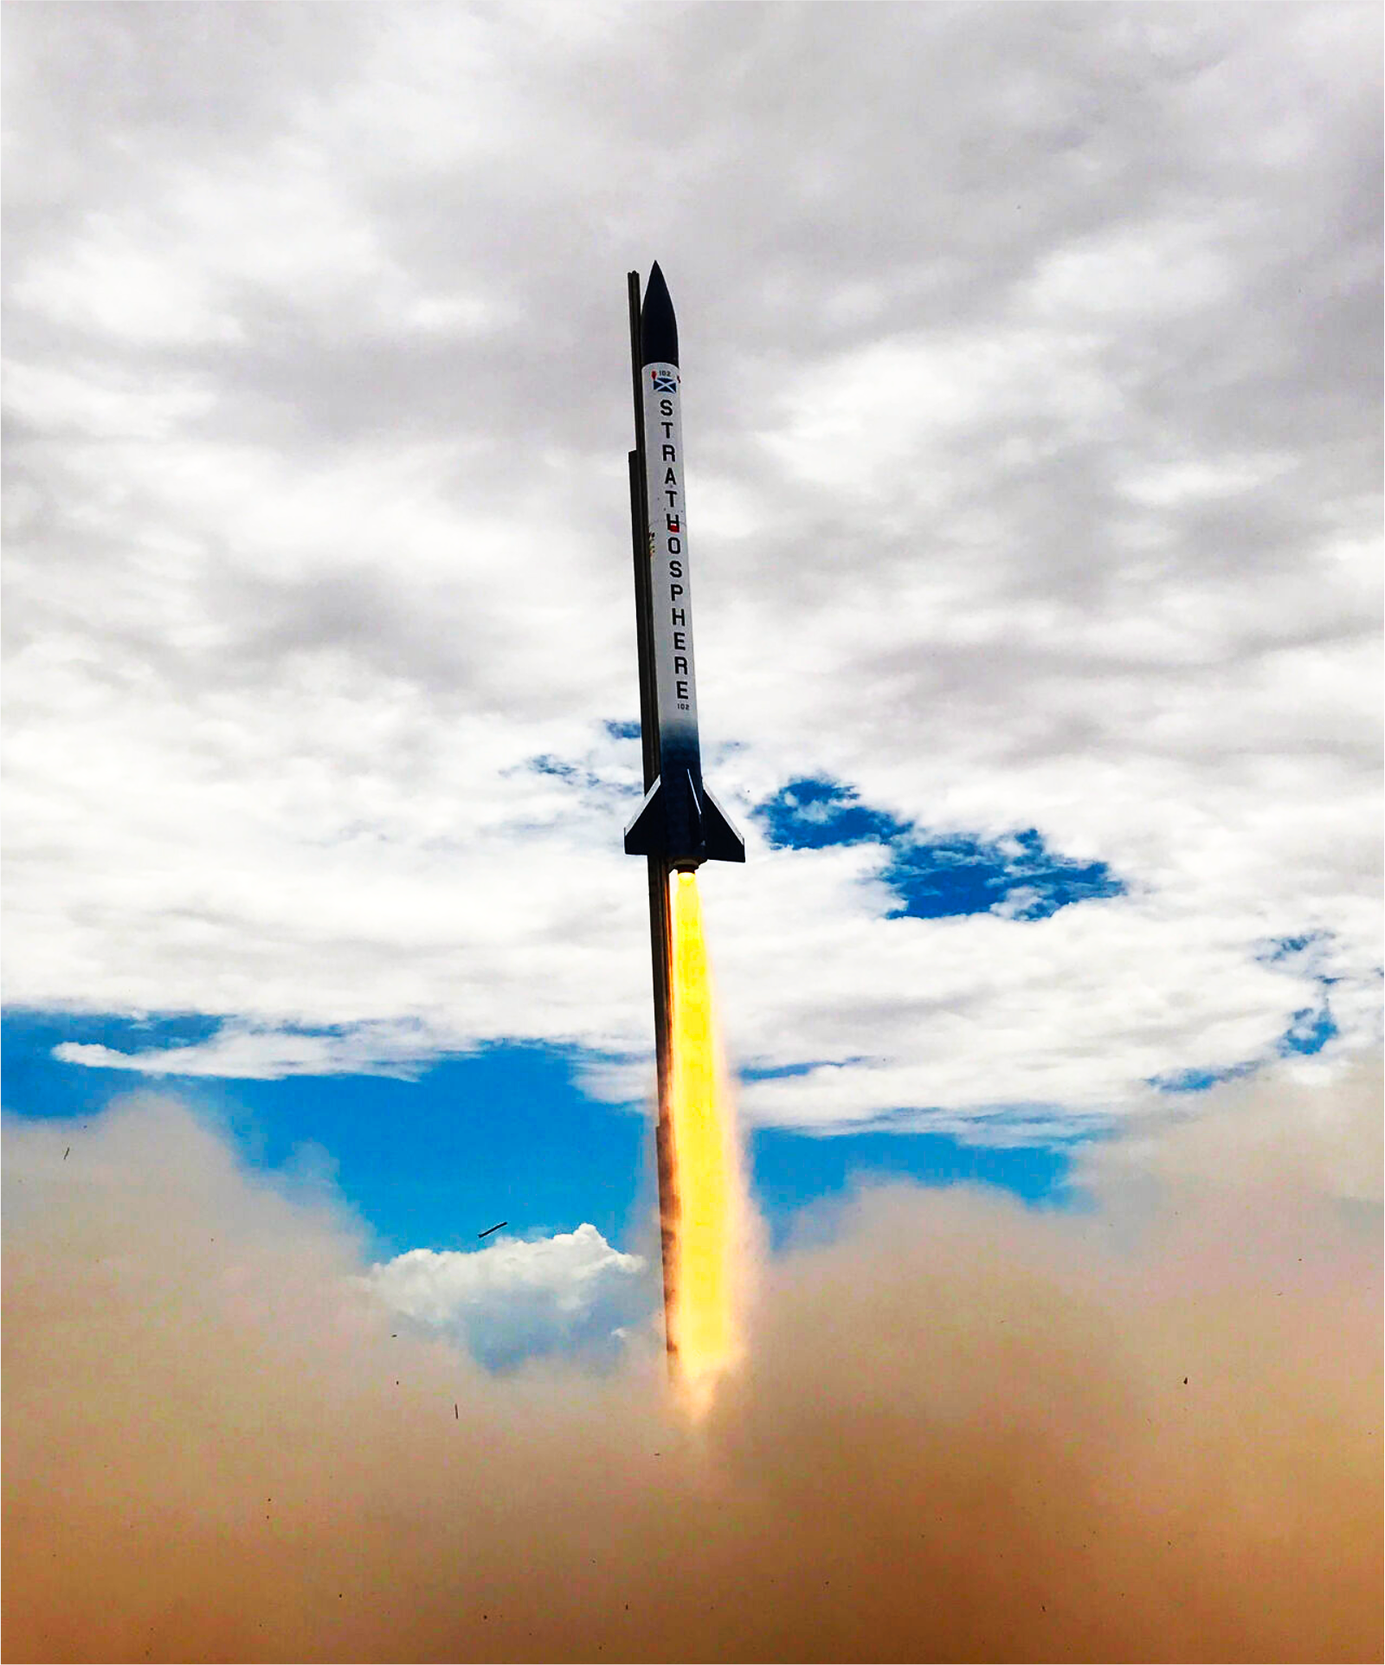
Avionics

Slide 2
Quick note
Good work at the pcb tutorial yesterday

Slide 3
This meeting’s going to be more free form
Power management
Telemetry visualization
SRAD flight computer
SRAD radio
SRAD GPS

Slide 4
Right, you’re all bored as hell now
What’ve you lot got to say to me?
I’m sure you have notes

Slide 5
Konrad and Arun
I have stuff to say on GPS stuff.
This is a threat.

